Slide 1
String Matching
∑ = {a, b, c, …, z}
∑* (Sigma-star) = set of all finite-length strings of alphabet sigma Given a pattern P[1..m] and a text T[1..n], find all occurrences of P in T. Both P and T belong to ∑*.
P occurs with shift s (beginning at s+1): P[1]=T[s+1], P[2]=T[s+2],…,P[m]=T[s+m].
If so, call s is a valid shift, otherwise, an invalid shift.
Note: one occurrence begins within another one: P=abab, T=abcabababbc, P occurs at s=3 and s=5.

Slide 2

String Matching Problem
Problem: Find all valid shifts s with which a given pattern P occurs in a given text T
This problem occurs in text editing, DNA sequence searches, and Internet search engines
Example:

Slide 3
Notation and Terminology
(Sigma-star) = set of all finite-length strings of alphabet sigma (ϵ is empty string)
String w is a prefix of string x, denoted w x, if x = wy for some string y
String w is a suffix of string x, denoted w x, if x = yw for some string y
Example: ab abcca and cca abcca

Slide 4
Problem Re-statement in notation/terminology
Denote a k-char prefix P[1..k] of pattern P by Pk
Similarly, denote a k-char prefix of text T by Tk
Matching problem: Given n = T.length and m = P.length, find all shifts s in range 0<=s<=n-m such that

Slide 5
Lemma : Overlapping shift lemma
Suppose x,y,z and x z and y z, then
  if |x|≤|y|, then x y;
  if |x| ≥ |y|, then y x;
  if |x| = |y|, then x=y.

Slide 6
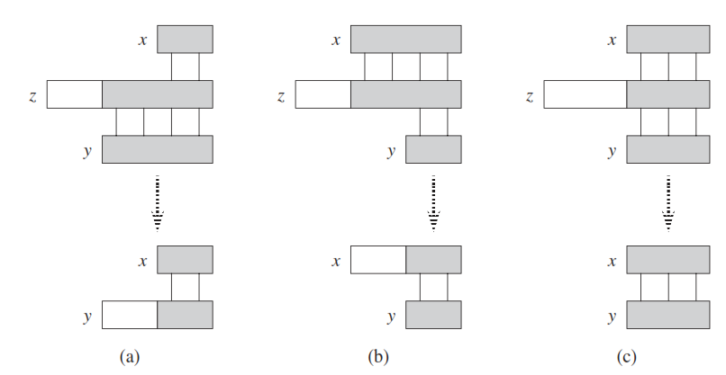
Graphical Proof of Lemma

Slide 7
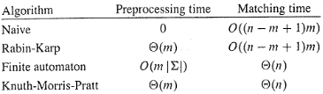
String Matching Algorithms
Preprocessing & Matching Times

Slide 8
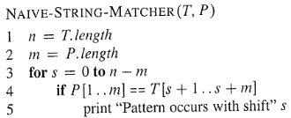
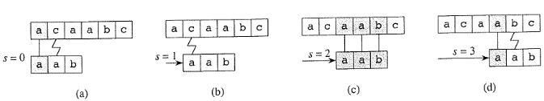
Naïve String Match Algorithm sliding “template” pattern match
Running time: O((n-m+1)m).

Slide 9
Problem with naïve algorithm
Problem with Naïve algorithm:
  Suppose p=ababc, T=cabababcd.
T: c a b a b a b c d
P: a …
P: a b a b c
P: a…
P: a b a b c
Whenever a character mismatch occurs after matching of several characters, the comparison begins by going back in T from the character which follows the last beginning character.
Can we do better: not go back in T?

Slide 10
Rabin-Karp Algorithm
Assume each character is digit in radix-d notation (e.g. d=10)
p = decimal value of pattern
t_{s} = decimal value of substring T[s+1..s+m] for s = 0,1...,n-m
Strategy:
  compute p in O(m) time (which is in O(n))
  compute all t_{i} values in total of O(n) time
  find all valid shifts s in O(n) time by comparing p with each t_{s}
Compute p in O(m) time using Horner’s rule:
  p = P[m] + d(P[m-1] + d(P[m-2] + ... + d(P[2] + dP[1])))
Compute t₀ similarly from T[1..m] in O(m) time
Compute remaining t_{i}‘s in O(n-m) time
  t_{s+1} = d(t_{s} - d ^{m-1}T[s+1]) + T[s+m+1]

Slide 11
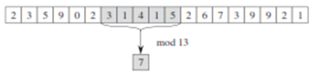
Rabin-Karp Algorithm
p, t_{s} may be large, so use mod

Slide 12
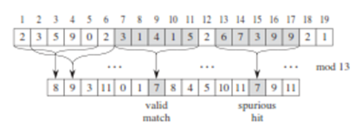
Rabin-Karp Algorithm (continued)
  t_{s+1} = d(t_{s} - d ^{m-1}T[s+1]) + T[s+m+1]

Slide 13
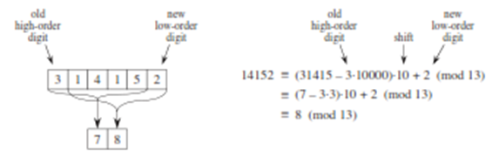
Rabin-Karp Algorithm (continued)

Slide 14
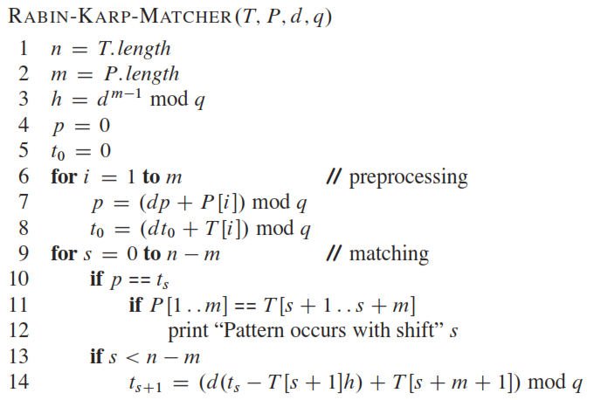
Rabin-Karp Algorithm (continued)
worst-case running time is in Θ((n-m+1)m)

Slide 15
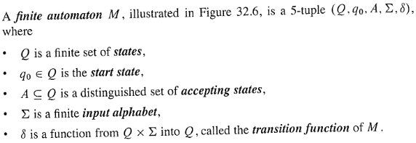
Finite Automata Algorithm
Efficient – examine each text char only once

Slide 16
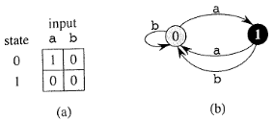
Finite Automata Algorithm
Example: simple two-state finite automaton:
Transition function (delta)
State transition diagram

Slide 17
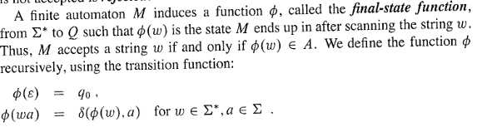
Finite Automata Algorithm
Final-state function
Final-state function (phi)

Slide 18
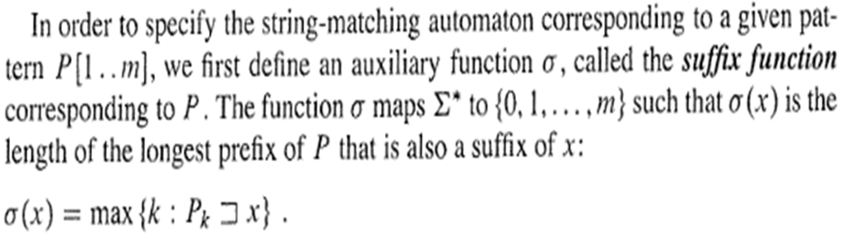
Finite Automata Algorithm
Construct the automaton
Suffix function (small sigma)

Slide 19
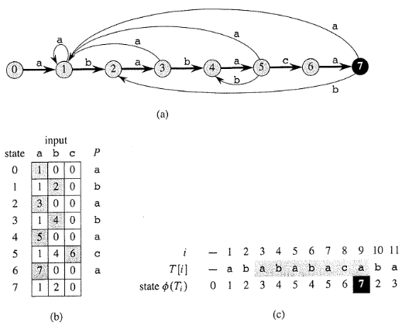
Finite Automata Algorithm
Construct the automaton
Example:
State m
P = a b a b a c a

Slide 20
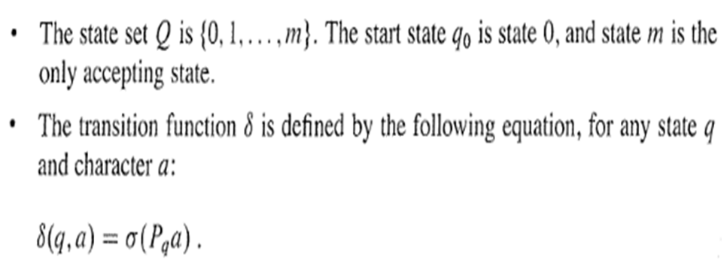
Finite Automata Algorithm
Critical transition function (delta)
Transition function (delta) obtained from Suffix function (small sigma)

Slide 21
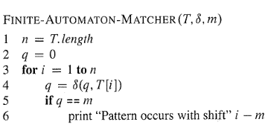
Finite Automata Algorithm
Matching operation
Transition function (delta)

Slide 22
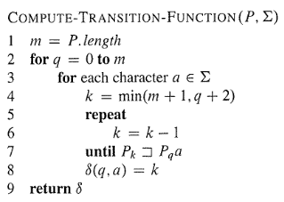
Finite Automata Algorithm
Compute transition function
Transition function (delta)

Slide 23
Knuth-Morris-Pratt (KMP) algorithm
Idea: after some character (such as q) matches of P with T and then a mismatch, the matched q characters allows us to determine immediately that certain shifts are invalid. So directly go to the shift which is potentially valid.
The matched characters in T are in fact a prefix of P, so just from P, it is easy to determine whether a shift is invalid or not.
Define a prefix function π, which encapsulates the knowledge about how the pattern P matches against shifts of itself.
  π :{1,2,…,m}→{0,1,…,m-1}
  π[q]=max{k: k<q and P_{k} P_{q}}, that is π[q] is the length of the longest prefix of P that is a proper suffix of P_{q}.

Slide 24
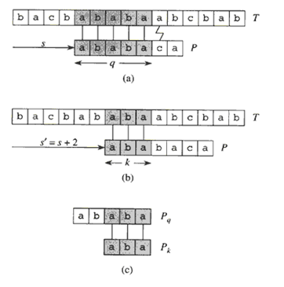
Prefix function
If we precompute prefix function of P (against itself), then whenever a mismatch occurs, the prefix function can determine which shift(s) are invalid and directly ruled out. So move directly to the shift which is potentially valid. However, there is no need to compare these characters again since they are equal.

Slide 25
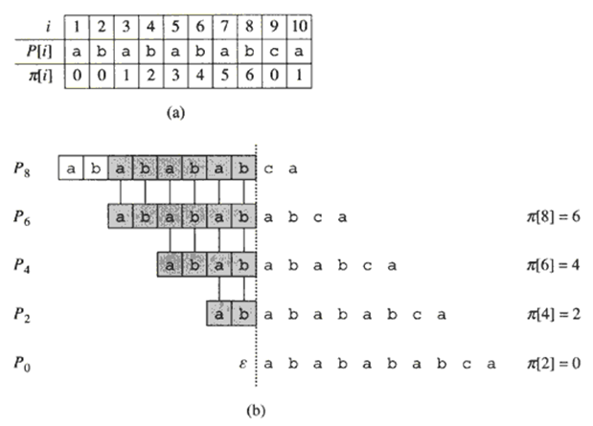

Slide 26
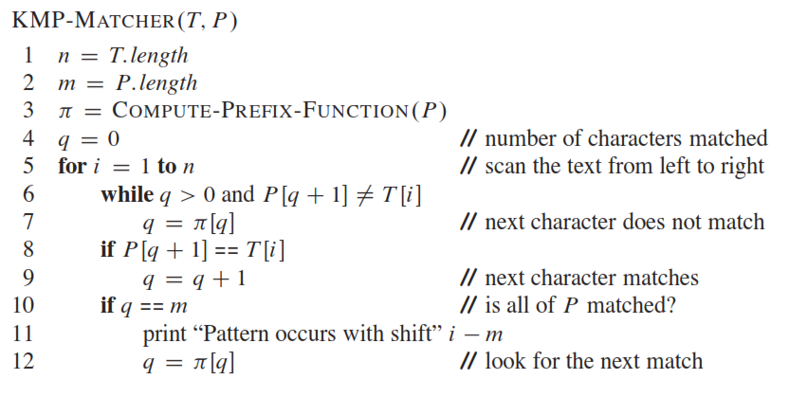

Slide 27
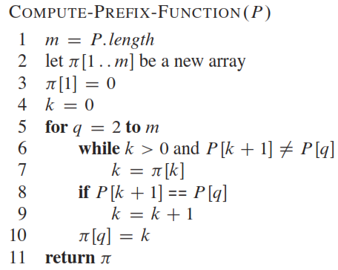

Slide 28
Analysis of KMP algorithm
Running time:
  COMPUTE-PREFIX-FUNCTION : Θ(m)
  KMP-MATCHER : Θ(m)+ Θ(n).

